Slide 1


The Art of Design Patterns
2023
Notes:
Greetings , welcome to the Art of design patterns + Who am I?

Slide 2



Three types of Design Patterns👌🏻
Creational
Behavioral
Structural

Slide 3
Agenda
Behavioral Design Patterns
Chain of Responsibility
Strategy
Observer
Behavioral

Slide 4
Behavioral Design Patterns
Behavioral design patterns how objects collaborate and communicate within a system. They focus on interactions between objects, managing responsibilities, and controlling the flow of execution.
Notes:
Usually deals with constructors, object creation

Slide 5
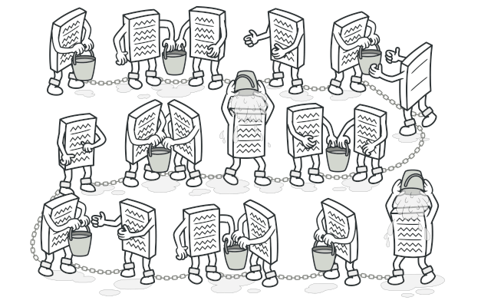
Chain of Responsibility

Slide 6

Do you know this Logo?

Slide 7
Riot Games
Imagine that Riot Games is developing a new game, and they need a bug reporting system to handle issues reported by players during testing. Different types of bugs need to be addressed by different teams within the company: Gameplay Bugs, Graphics Bugs, and Connectivity Bugs.

Slide 8
Riot Games
Different types of bugs:
Gameplay Bugs
Graphics Bugs
Connectivity Bugs.

Slide 9
Riot Games
Basic Solution is:
Bug Reporting System:
This is the central component responsible for receiving bug reports from players and forwarding them to the appropriate bug handling teams.

Slide 10
Riot Games
Basic Solution is:
Bug Handling Teams:
Different teams within the company (Gameplay, Graphics, Connectivity) are responsible for handling specific types of bugs.

Slide 11
Problem!

Slide 12
Problem!
The bug reporting system needs to have direct knowledge of which bug handling team should handle which type of bug.

Slide 13
Problem!
Bugs Types
Audio Bug
Localization Bug
Performance Bug
Account Bug
Server Bug

Slide 14
Chain of Responsibility
is a behavioral design pattern that lets you pass requests along a chain of handlers. Upon receiving a request, each handler decides either to process the request or to pass it to the next handler in the chain.

Slide 15


Slide 16


Slide 17


Slide 18
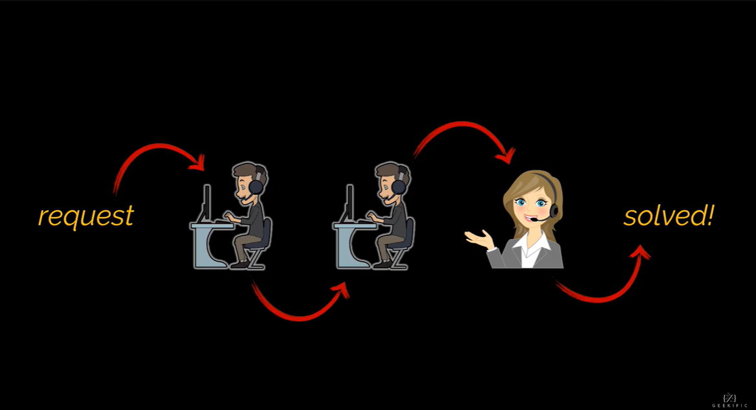

Slide 19
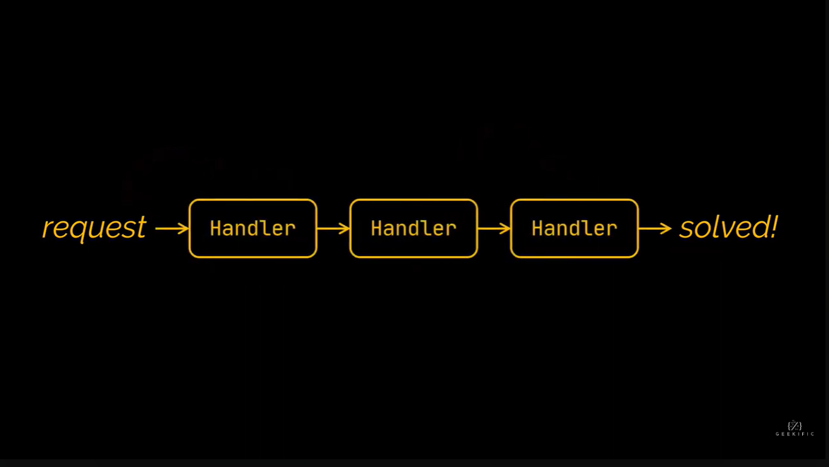

Slide 20
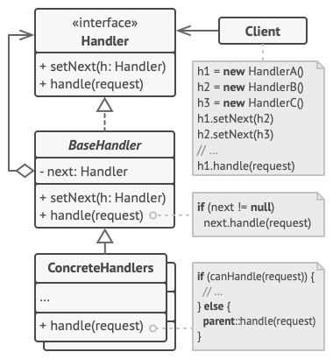
Chain of Responsibility

Slide 21
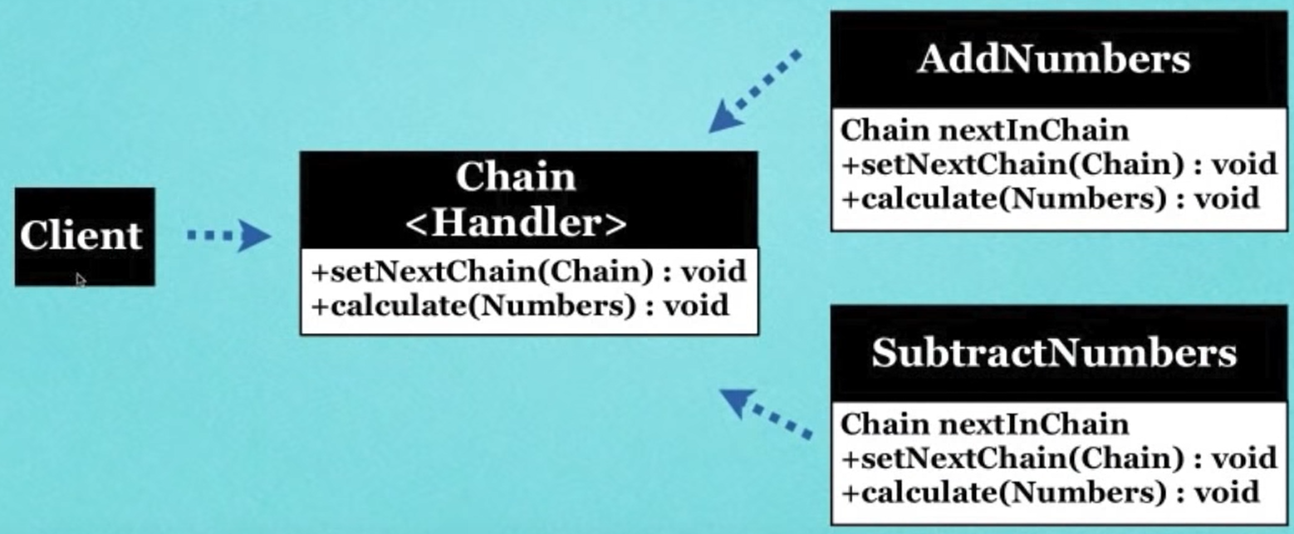
Simple Scenario

Slide 22
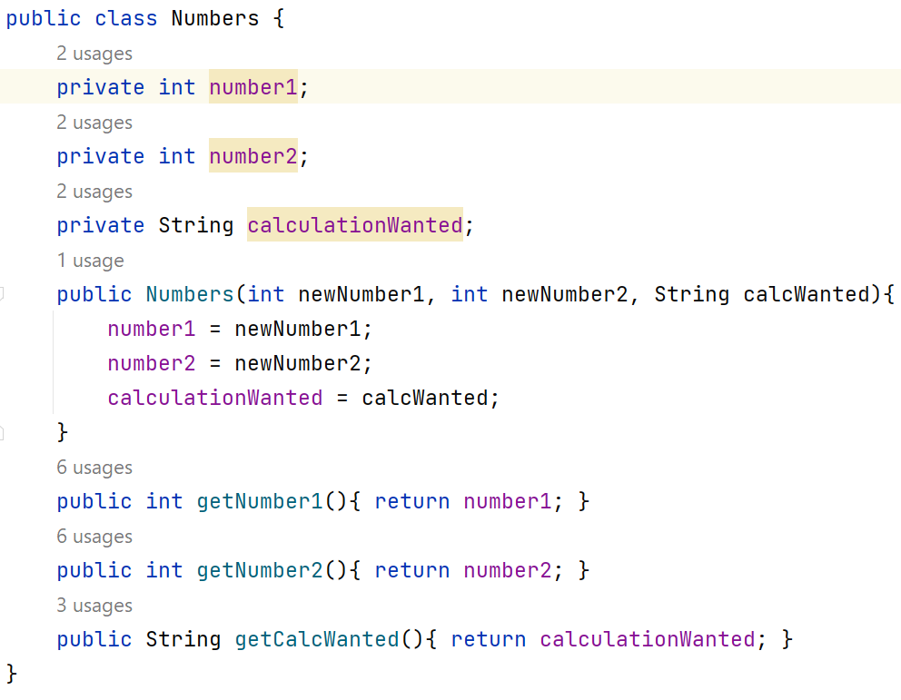
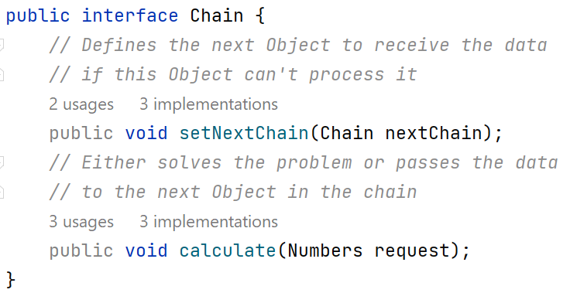
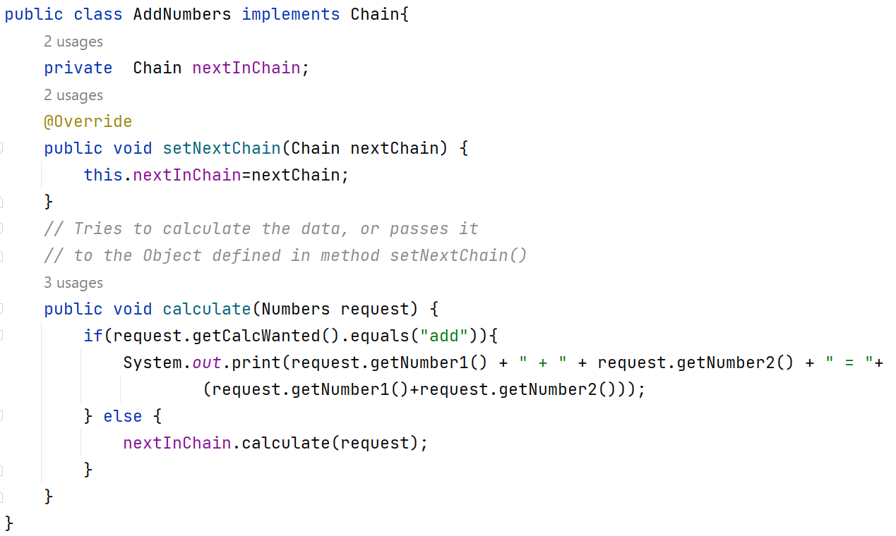
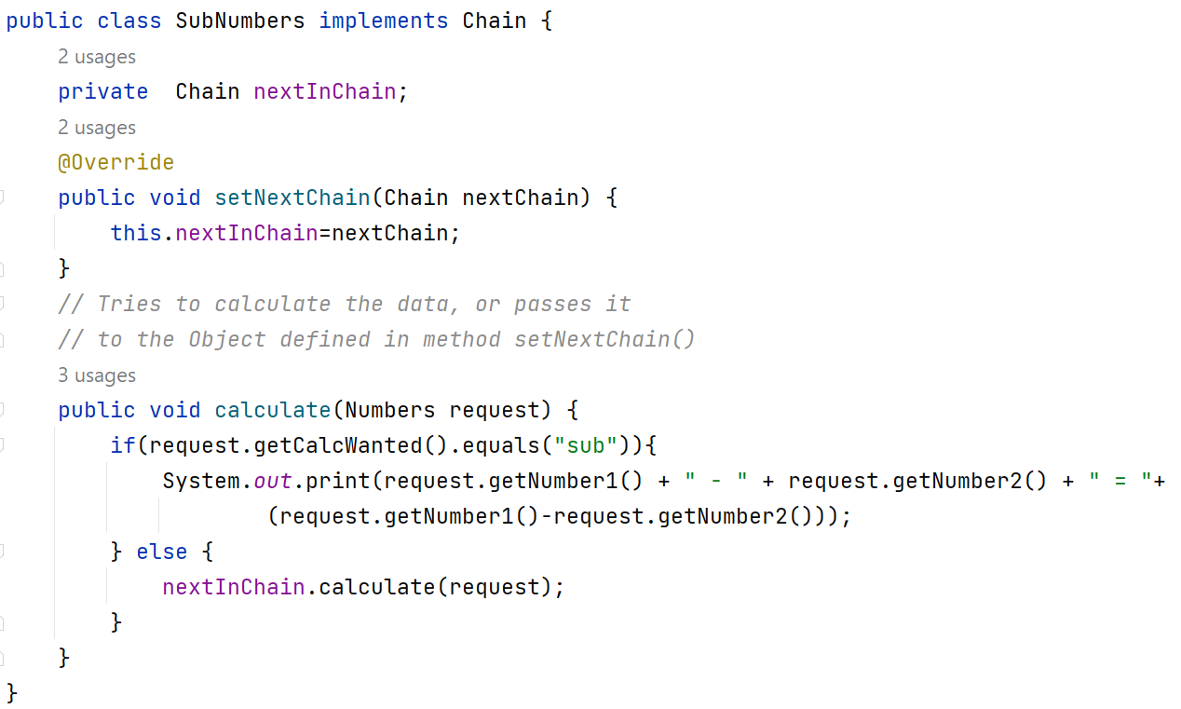
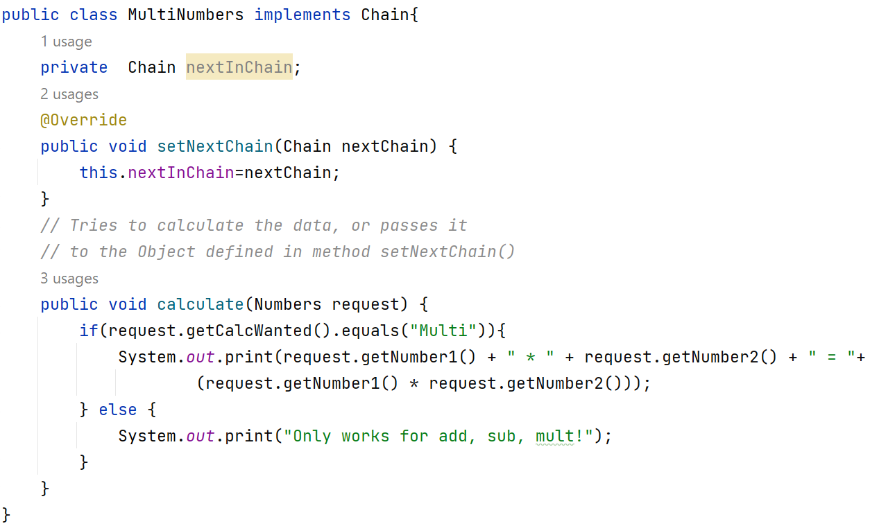
Solution

Slide 23
Solution

Slide 24
Solution

Slide 25
Solution

Slide 26
Solution

Slide 27
Solution

Slide 28
Solution

Slide 29
Solution

Slide 30
Solution

Slide 31
Solution

Slide 32

Advantages
You can control the order of request handling.
Single Responsibility Principle. You can decouple classes that invoke operations from classes that perform operations.
Open/Closed Principle. You can introduce new handlers into the app without breaking the existing client code.

Slide 33

Disadvantages
Some requests may end up unhandled.

Slide 34

Any Questions?

Slide 35

Strategy

Slide 36
Mini Uber

Slide 37
Mini Uber
One of the most requested features for the app was automatic route planning. A user should be able to enter an address and see the fastest route to that destination displayed on the map.
The first version of the app could only build the routes over roads for People who traveled by car

Slide 38
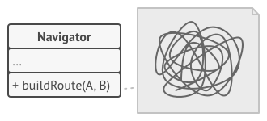
Mini Uber (Problem!)
Not everybody likes to drive on their vacation!
build walking routes
route building for public transport
route building for cyclists.

Slide 39
Mini Uber (Problem!)
Each time you added a new routing algorithm, the main class of the navigator doubled in size. At some point, the beast became too hard to maintain.
Any change to one of the algorithms, whether it was a simple bug fix or a slight adjustment of the street score, affected the whole class

Slide 40
Strategy
is a behavioral design pattern that lets you define a family of algorithms, put each of them into a separate class, and make their objects interchangeable.

Slide 41
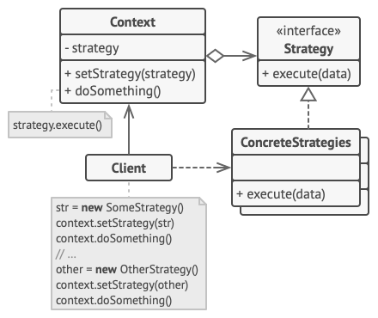
Strategy

Slide 42
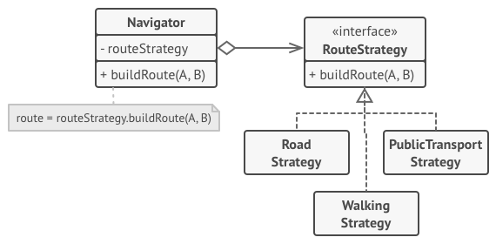
Mini Uber (Solution!)

Slide 43
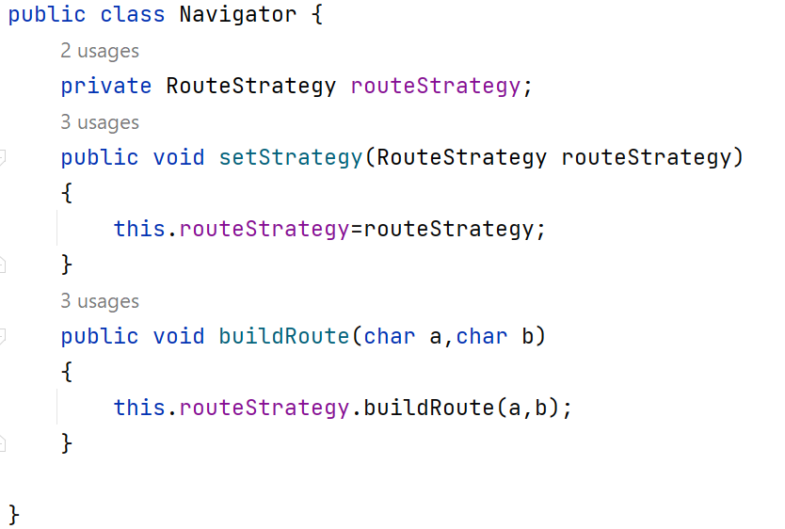
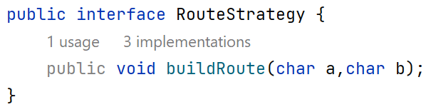
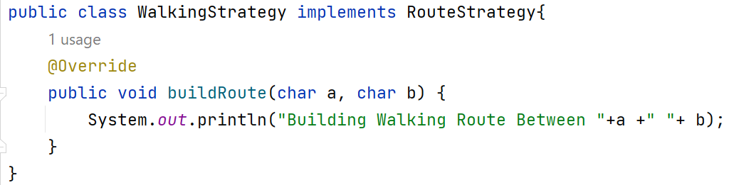
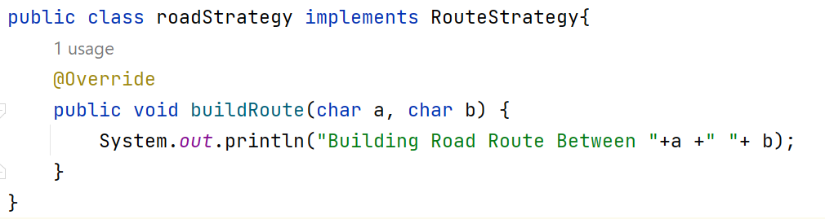
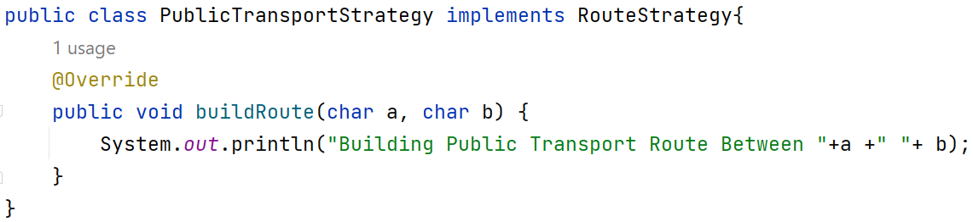
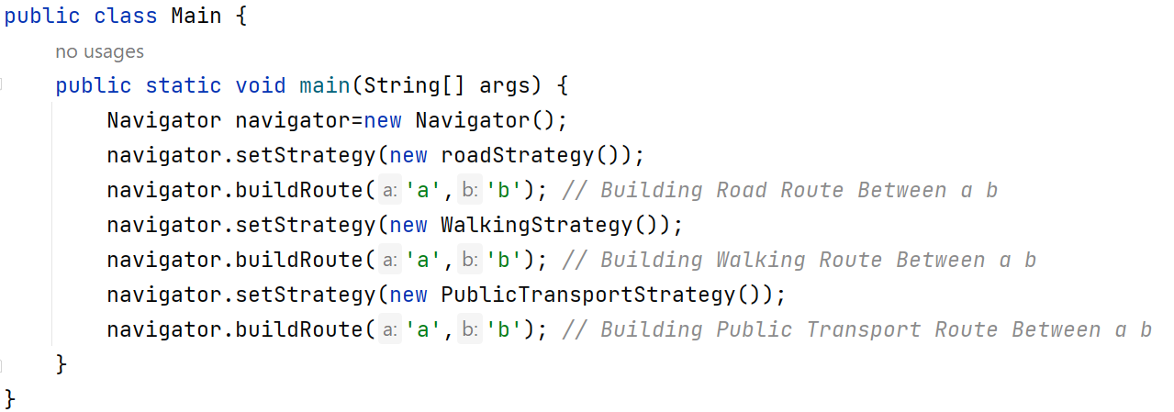
Mini Uber (Solution!)

Slide 44
Mini Uber (Solution!)

Slide 45
Mini Uber (Solution!)

Slide 46

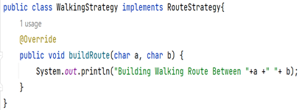

Mini Uber (Solution!)

Slide 47
Mini Uber (Solution!)

Slide 48
Mini Uber (Solution!)

Slide 49

Your Turn!! Add Payment Methods to Mini Uber
Based on Strategy design patten Add :
Paypal Payment Method
Credit Card Method

Slide 50
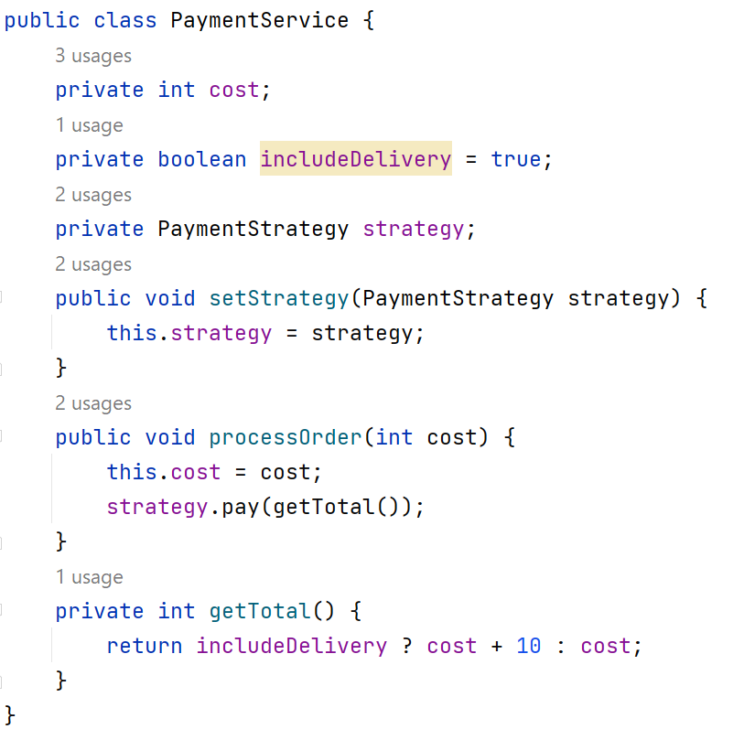
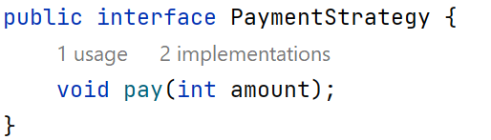
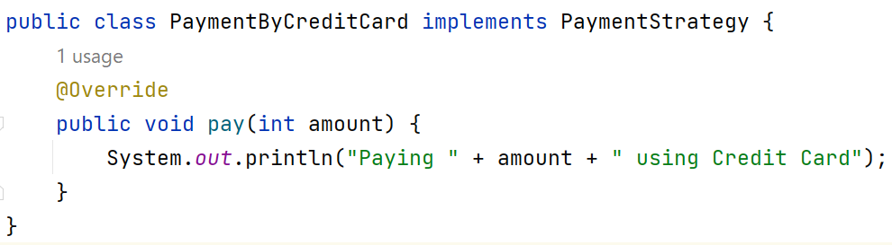
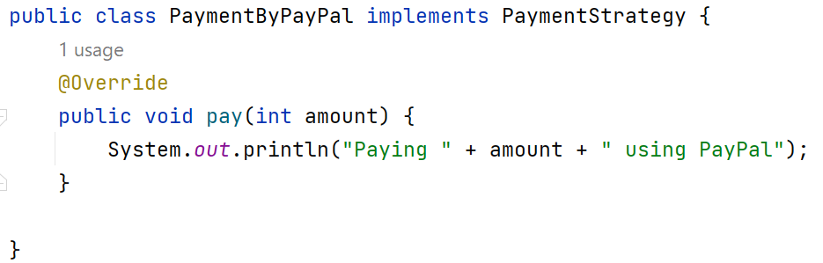
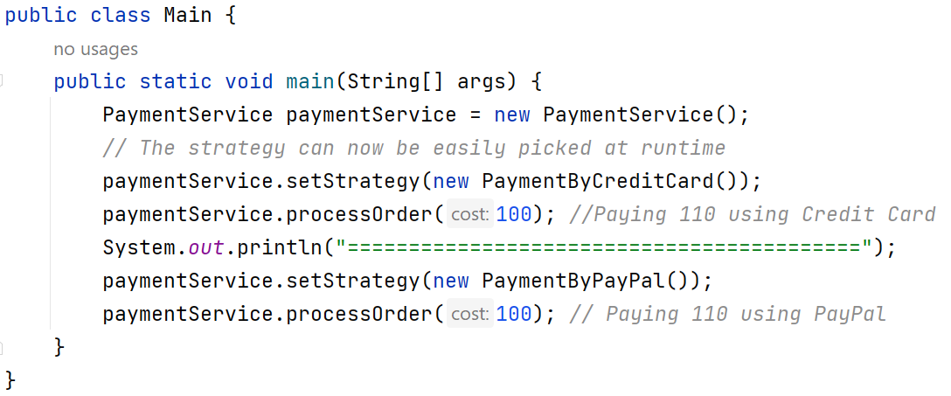
Mini Uber (Solution!)

Slide 51
Solution!

Slide 52
Solution!

Slide 53
Solution!

Slide 54
Solution!

Slide 55
Solution!

Slide 56
Advantages
You can swap algorithms used inside an object at runtime.
You can isolate the implementation details of an algorithm from the code that uses it.
You can replace inheritance with composition.
Open/Closed Principle. You can introduce new strategies without having to change the context.

Slide 57
Disadvantages
If you only have a couple of algorithms and they rarely change, there’s no real reason to overcomplicate the program with new classes and interfaces that come along with the pattern.
Clients must be aware of the differences between strategies to be able to select a proper one.
A lot of modern programming languages have functional type support that lets you implement different versions of an algorithm inside a set of anonymous functions. Then you could use these functions exactly as you’d have used the strategy objects, but without bloating your code with extra classes and interfaces.

Slide 58
Any Questions?

Slide 59

Break

Slide 60
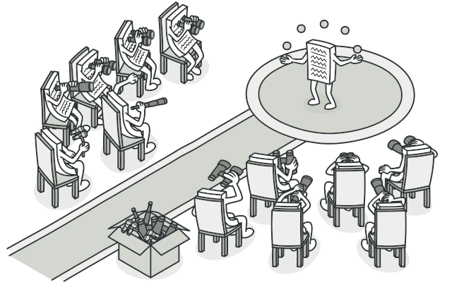
Observer

Slide 61
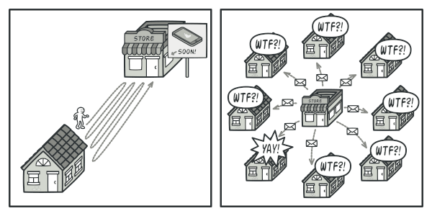
Real World Scenario
Waiting for the release of new Product:
visit the store every day and check product availability. But while the product is still in route, most of these trips would be pointless.

Slide 62
Real World Scenario
Waiting for the release of new Product:
the store could send tons of emails to all customers each time a new product becomes available.

Slide 63
Real World Scenario
the store could send tons of emails to all customers each time a new product becomes available:
his would save some customers from endless trips to the store.
might be considered spam
it’d upset other customers who aren’t interested in new products.

Slide 64
Observer
is a behavioral design pattern that lets you define a subscription mechanism to notify multiple objects about any events that happen to the object they’re observing.

Slide 65
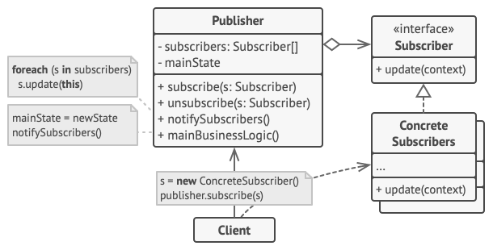
Observer

Slide 66
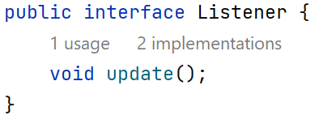
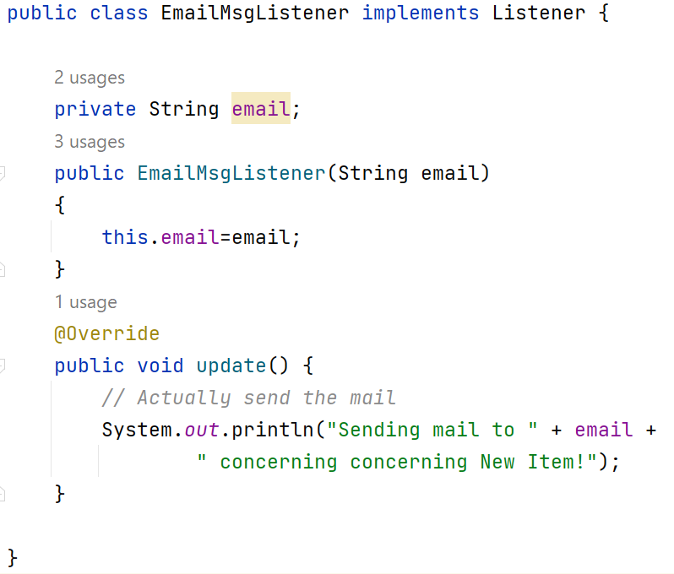
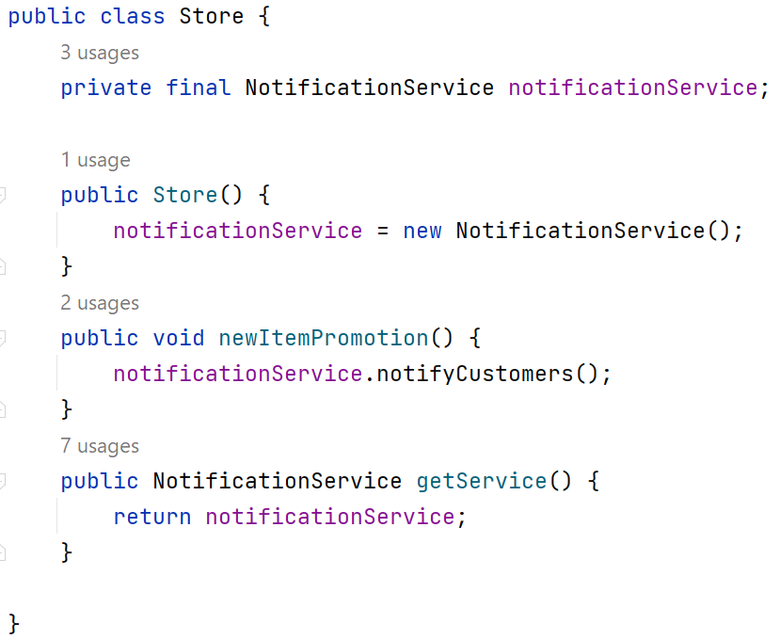
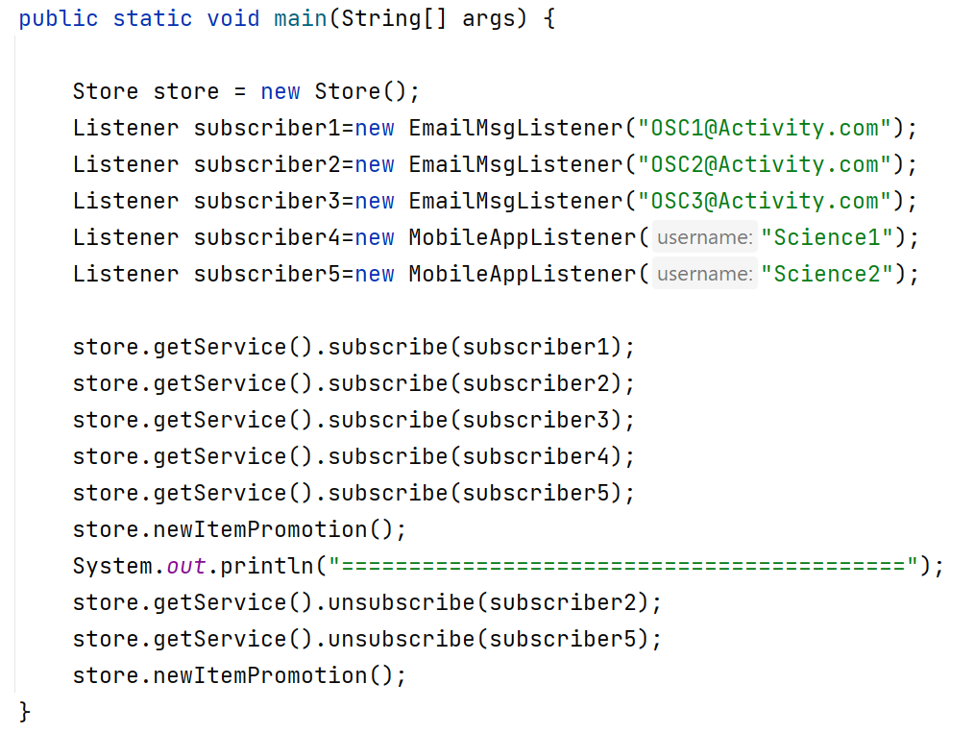
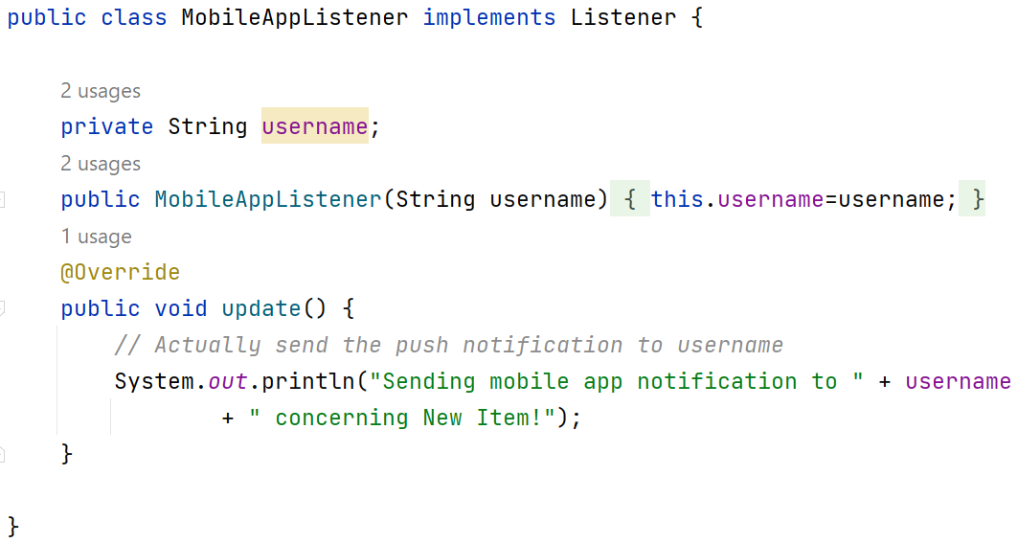
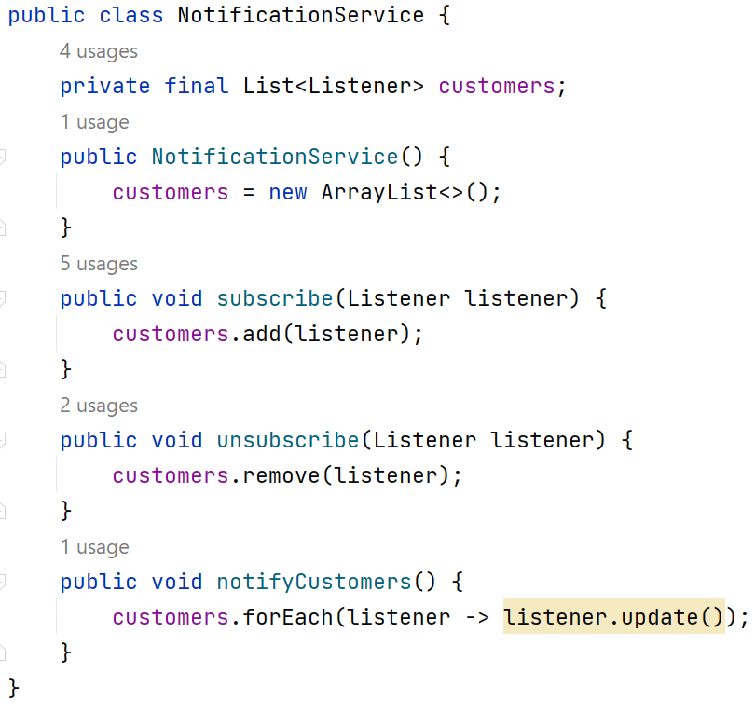
Solution!

Slide 67
Solution!

Slide 68
Solution!

Slide 69
Solution!

Slide 70
Solution!

Slide 71
Solution!

Slide 72
Solution!

Slide 73
Solution!

Slide 74
Solution!

Slide 75
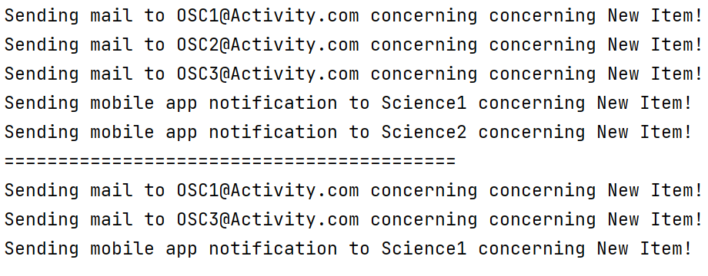
OutPut

Slide 76
Advantages
Open/Closed Principle. You can introduce new subscriber classes without having to change the publisher’s code (and vice versa if there’s a publisher interface).
You can establish relations between objects at runtime.

Slide 77
Disadvantages
Subscribers are notified in random order.

Slide 78
Any Questions?

Slide 79
Thank you

